Slide 1
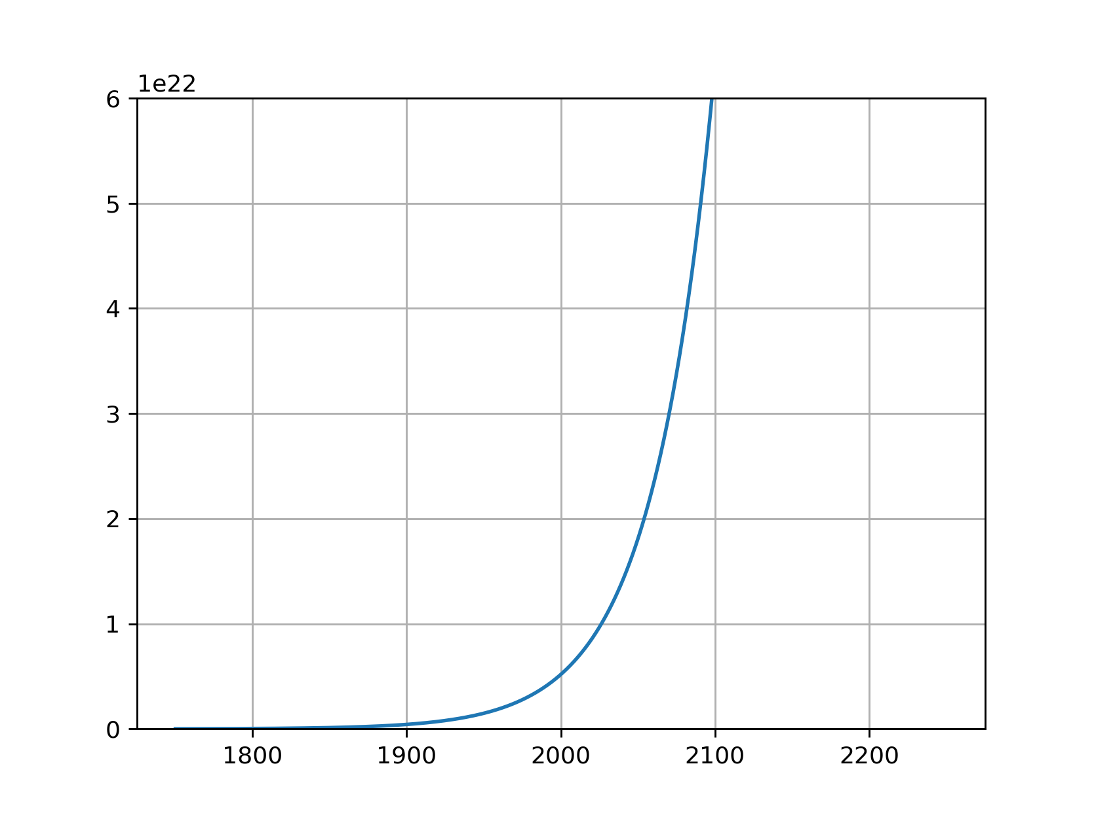
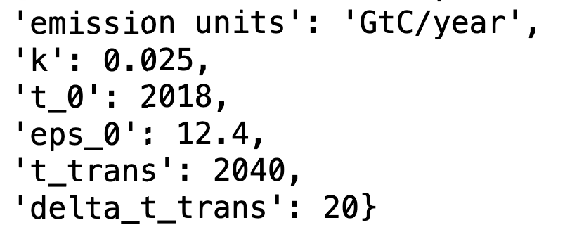
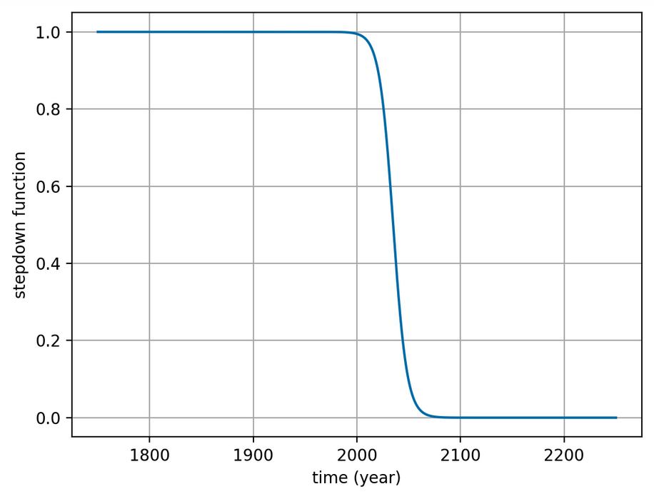
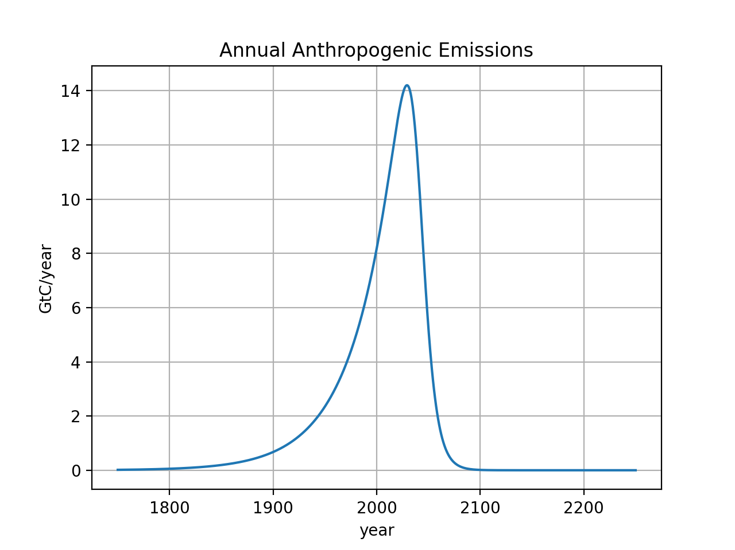


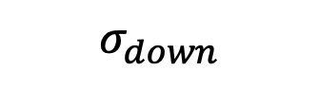
5a.ScheduledFlows … here a possible schedule of emissions (past & future)
$$exp⁡(kt)$$
$$σ_{down}$$
$${\exp\left(kt\right)× σ}_{down}×N$$

Slide 2
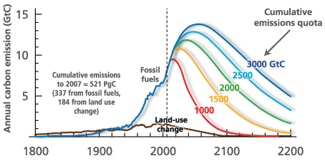
This scenario vs other scenarios
http://www.igbp.net/news/features/features/havewereachedpeakco2.5.1b8ae20512db692f2a680003465.html
Notes:
http://www.igbp.net/news/features/features/havewereachedpeakco2.5.1b8ae20512db692f2a680003465.html

Slide 3
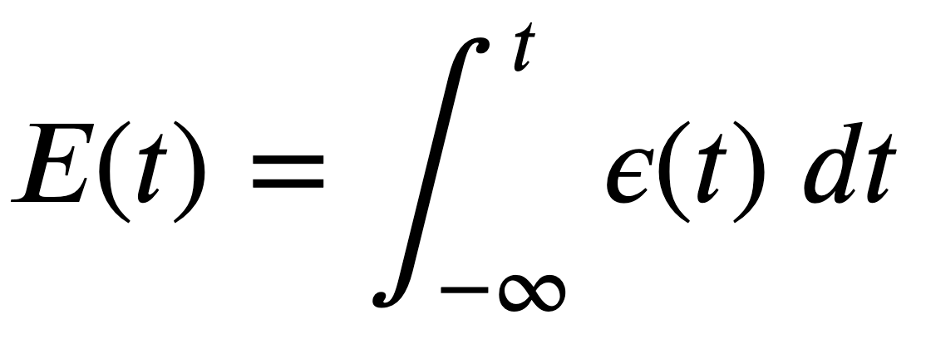
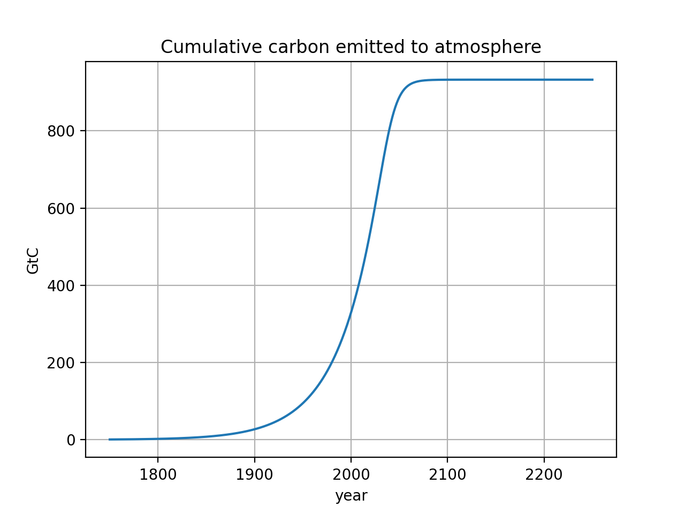
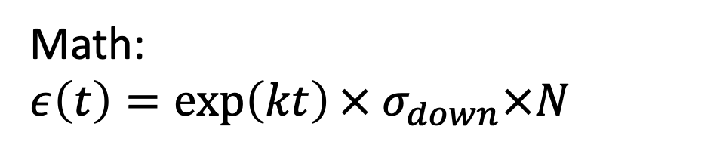
5b. CumulativeAnalysis
Math:
$$ε\left(t\right)={\exp\left(kt\right)× σ}_{down}×N$$
Integral calculus math:
Almost 1000 GtC eventually burned
It’s thought that ~4000 GtC is the total Earth reserve, so ~75% will be left in the ground
In CumulativeAnalysis:
Notes:
http://www.igbp.net/news/features/features/havewereachedpeakco2.5.1b8ae20512db692f2a680003465.html

Slide 4
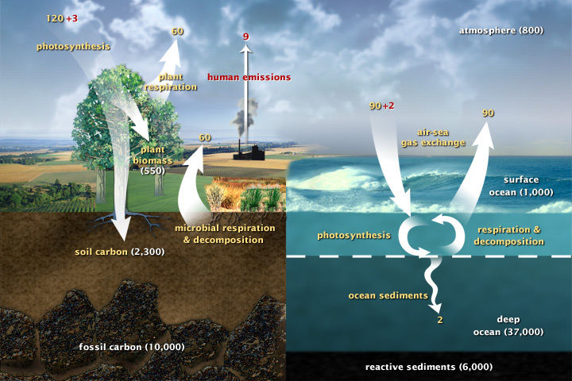
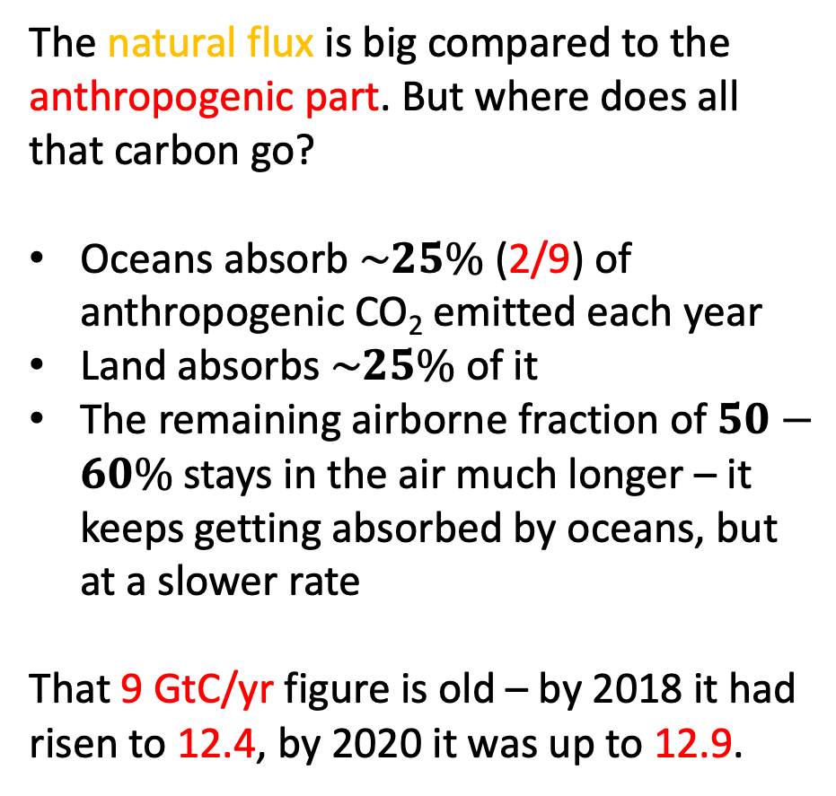
5c.AdaptiveFlows
The natural flux is big compared to the anthropogenic part. But where does all that carbon go?
Oceans absorb $\sim 25\%$(2/9) of anthropogenic CO₂ emitted each year
Land absorbs $\sim 25\%$of it
The remaining airborne fraction of $50−60\%$ stays in the air much longer – it keeps getting absorbed by oceans, but at a slower rate
That 9 GtC/yr figure is old – by 2018 it had risen to 12.4, by 2020 it was up to 12.9.
https://earthobservatory.nasa.gov/features/CarbonCycle
0:00 / 3:10 NASA | A Year in the Life of Earth's CO2

Slide 5
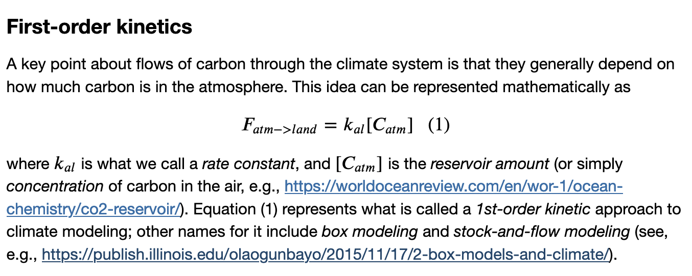
Using first-order kinetics to describe carbon flows
Basically, this says that the atmosphere-to-land flux of carbon (F_{atm->land}) increases in proportion to the concentration of CO₂ in the air, ([C_{atm}]). But there are limits to this, because Land Ecosystems Are Becoming Less Efficient at Absorbing Carbon Dioxide.

Slide 6
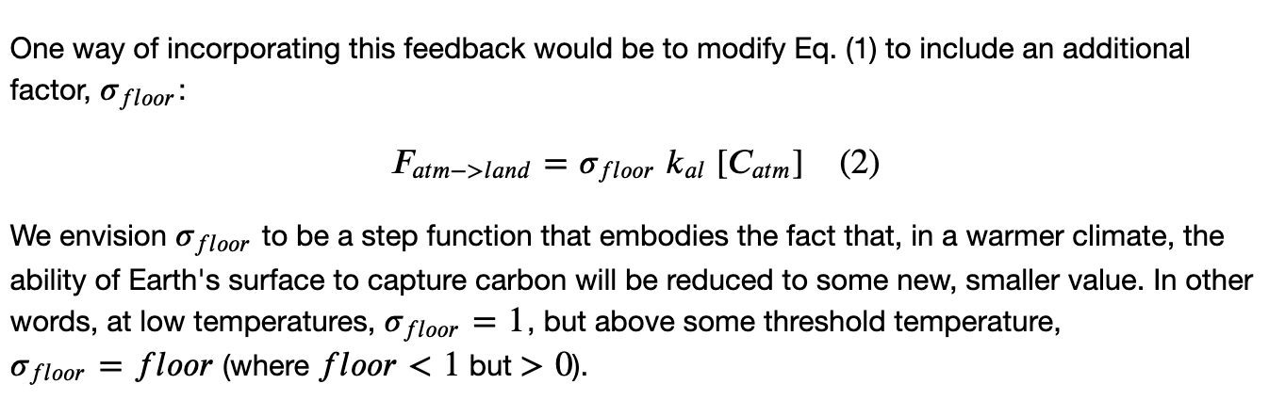
Adaptive first-order kinetics (to include feedback effects)

